Slide 1
Iteration 2
The Three Amigos

Slide 2
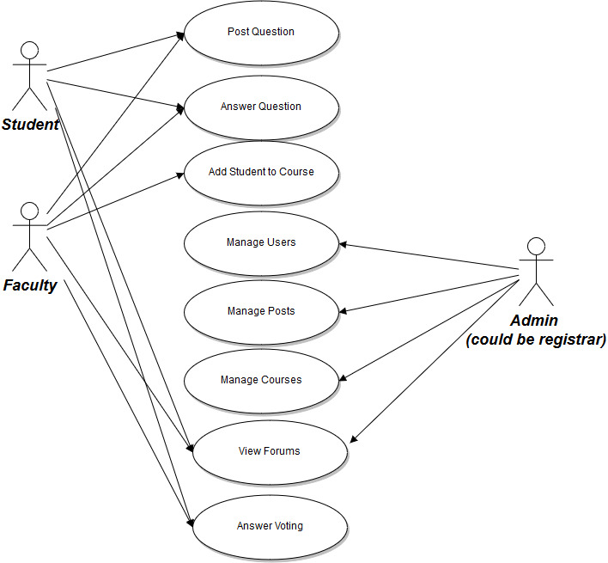
Additional Use Cases
UC5 Add Student to Course
UC6 Manage Courses
UC7 View Forums
UC8 Answer Voting

Slide 3
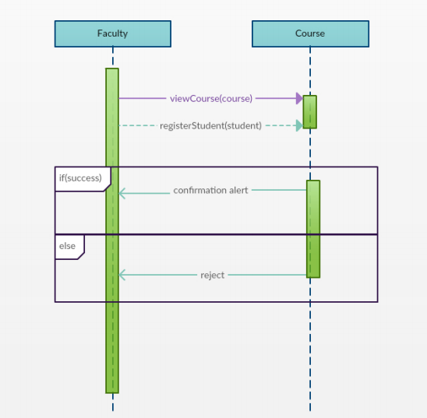
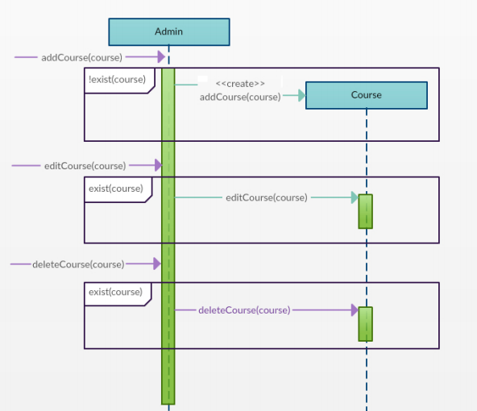
SSD for UC5 and UC6

Slide 4
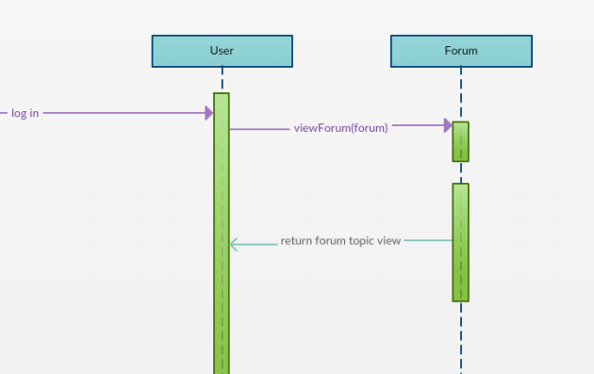
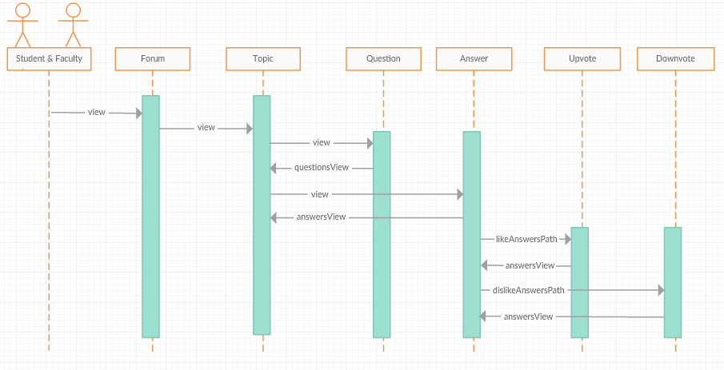
SSD for UC7 and UC8

Slide 5
Demo
https://mighty-anchorage-84460.herokuapp.com/

